Slide 1
Dynamic Analysis of a Voltage Mode Buck Converter
Final Project for ELEC 835
Xiang Zhang

Slide 2
Content
Introduction
State Space Equation in CCM VCM buck converter
Iteration Mapping in CCM VCM buck converter
Discrete iteration mapping for DCM buck converter
Stability Analysis under Discrete iteration map
Possible Application for Buck complex behavior
Conlusion

Slide 3
Introduction
Complex Behavior Research Techniques in DC-DC Switching Converters
To reveal the nonlinear dynamic behavior of the converter, the key issue is to establish a corresponding dynamic model with an appropriate method, two analysis methods are mainly used:
Complete system state equation
According to different switching states to derive all the operation topology, using KCL and KVL law, establish a unified state equation model and perform accurate model simulation;
Discrete iterative nonlinear mapping
By discretizing the system using state-space sampling, calculating the Jacobian matrix, computing eigenvalues;

Slide 4
Introduction
Comparation for two different analysis techniques
 | Complete system state equation | Discrete iterative nonlinear mapping
Pros | Accurate, all complex dynamic behavior are visible | Small calculation complexity, stability criteria can be easily found
Cons | Large calculation complexity, numeric simulation relies on sufficient resolution | Only suitable for first fork analysis in general
Visualization | Phase Portrait Bifurcation Plot (sampling) Poincare Map (sampling) | Bifurcation Plot Poincare Map Iterative map

Slide 5
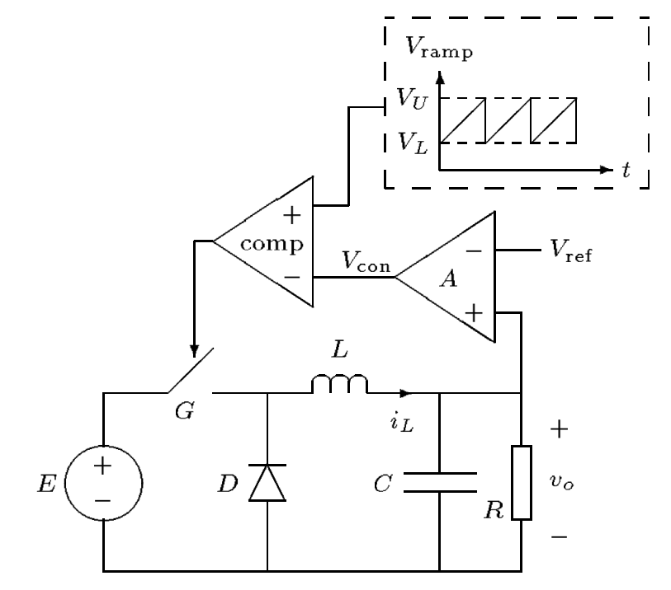
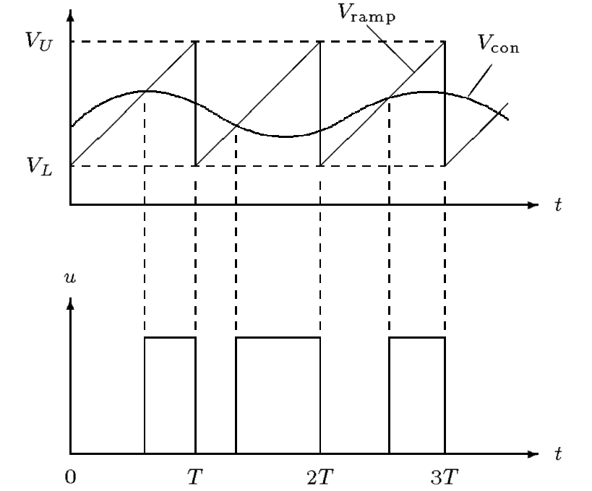
Introduction of complex behavior in VMC Buck
Bifurcation phenomenon in CCM Voltage Mode Buck Converter
For voltage controlled buck converter, both circuit parameters and control values may derive complex behavior in buck converter.
Inductor value
Filter capacitor value
Input voltage
Load resister value
Voltage feedback gain
In fact, We can find the system behavior varies with parameter changes, in some range, the system performs stable; but when these parameters keep changing, the state of the system will lead to bifurcation and further unpredictable chaos.
Schematic diagram of Voltage Mode Buck Converter
Key operation waveform

Slide 6
Example of Complex behavior in VMC Buck
Bifurcation phenomenon in Voltage Mode CCM Buck Converter
The left diagram is a typical behavior bifurcation when the parameter changing, from input Voltage varies from 20V-35V, the state variables will go through one/two/three period and finally lead to chaos.
The simulation is based on PSIM
Border Collision

Slide 7
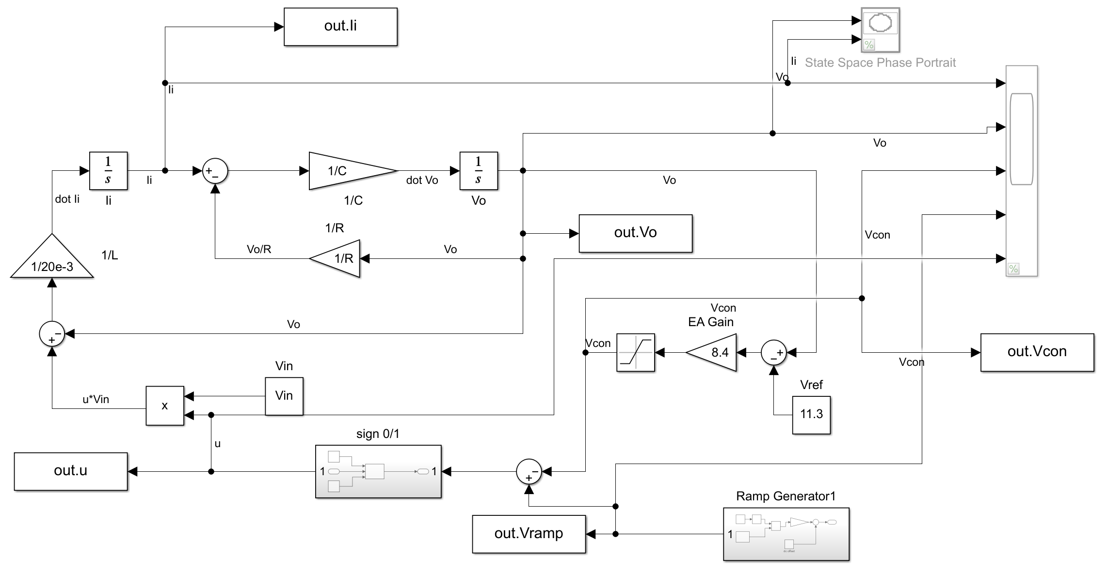

The structruallable Numerical Modeling in Matlab
$$\dot{Vo}= \frac{i_{L}−Vo/R}{C}$$
$$\dot{i_{L}}= \frac{S(d)Vin−Vo}{L}$$
This model can perform numerical simulation, defeating the shortcoming of repeating trial and error in circuit simulation software.
The parameters used in the simulations are as follows:
Vin = 20~35V, L=10~20mH, C = 20~80 µF, R = 22 Ω, K= 8.3, Ts = 400 µs, VL = 3.8 V, VU = 8.2 V

Slide 8
Numeric Analysis with State Space Equation
Bifurcation Diagram Under Different Parameters
Period-4
Period-4
24.5V
Chaos
Chaos
Period-4
Chaos
51uF
18.2mH
31.2V
Stable
32.6V
Stable
Stable
Period-doubling
Period-doubling
Period-doubling
Input voltage as a parameter
go through stable –> period-doubling -> period-4 -> chaos
Inductor as bifurcation parameter
go through chaos –> period-4 -> period-doubling -> stable
Capacitor as bifurcation parameter
go through chaos –> period-4 -> period-doubling -> stable
As the figure show right, under specific condition Vin=27V, R =22Ω, L=20mH, C=47uF, fs=2500Hz, K=8.2, the matlab modeling has a satisfying consistent result compared to PSIM simulation.

Slide 9
Numeric Analysis with State Space Equation
Poincare Map with changing Input voltage
Sampling the state variables under the switching frequency Ts;
When Vin =31.8V, two-periodic orbit turns to four-periodic obit;
When Vin=33V a strange attractor is observed, chaos operation begins;
Strange Attractor
As the figure show left, under specific condition R=22Ω, L=20mH, C=47uF, fs =2500Hz the system state will go through 1-period->2period->4period->chaos

Slide 10


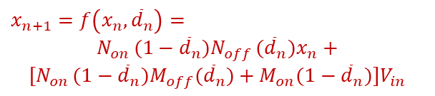
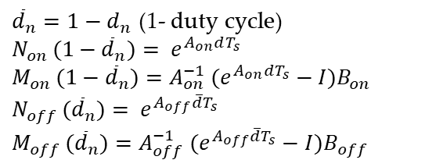

Theoretical Analysis with Iteration Mapping
Now, we consider to establish a discrete iterative mapping (Poincare map) and perform stability analysis through the calculation of eigenvalues.
Therefore, the discrete iterative map:
$$x_{n+1}=f\left(x_{n},{\overline{d}}_{n}\right)=$$
$$N_{on }(1−{\overline{d}}_{n})N_{off }({{\overline{d}}_{n})x}_{n}+$$
$$[N_{on }(1−{\overline{d}}_{n})M_{off}({\overline{d}}_{n})+M_{on}(1−{\overline{d}}_{n})]V_{in}$$
where,
${\overline{d}}_{n}=1−d_{n}$ (1- duty cycle)
$$N_{on }(1−{\overline{d}}_{n})= e^{A_{on}dT_{s}}$$
$$M_{on }(1−{\overline{d}}_{n})=A_{on}^{−1} (e^{A_{on}dT_{s}}−I)B_{on}$$
$$N_{off }({\overline{d}}_{n})= e^{A_{off}{\overline{d}T}_{s}}$$
$$M_{off }({\overline{d}}_{n})=A_{off}^{−1} (e^{A_{off}{\overline{d}T}_{s}}−I)B_{off}$$
When $t=t_{n}\sim t_{n+\overline{d}}$, switch is in "off state", when this interval ends, the state-variable $x_{n+\overline{d}}$
In addition, we need to derive the duty cycle function, which requires finding the relationship between the switching instant and the state variable:
$$x_{n+\overline{d}}=f_{off}\left(x_{n},{\overline{d}}_{n}\right)=N_{off }({{\overline{d}}_{n})x}_{n}+M_{off}({\overline{d}}_{n})V_{in}$$
When $t=t_{n+\overline{d}}\sim t_{n+1}$ switch is in “on state", when this interval ends, the state-variable $x_{n+1}$
$$x_{n+1}=f_{on}\left(x_{n+\overline{d}},{\overline{d}}_{n}\right)=N_{on }(1−{\overline{d}}_{n})x_{n+\overline{d}}+M_{on}(1−{\overline{d}}_{n})V_{in}$$
$$S\left({\overline{d}}_{n}\right)=V_{con }\left({\overline{d}}_{n}T_{s}\right)−V_{\begin{aligned}ramp \\ \end{aligned}}\left({\overline{d}}_{n}T_{s}\right)$$

Slide 11
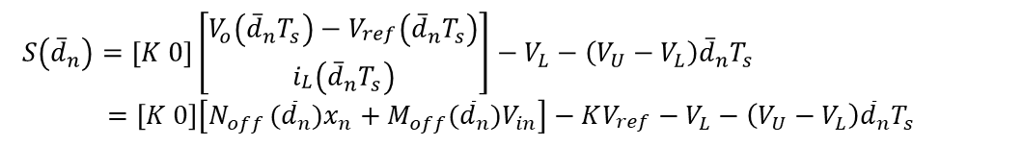
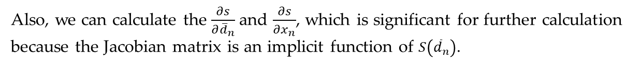
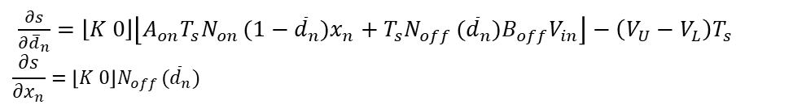
Theoretical Analysis with Iteration Mapping
In order to fully understand the exact switching timing, the $S\left({\overline{d}}_{n}\right)$ should be expand and correspond with state-variables, this tie relies on:
$S\left({\overline{d}}_{n}\right)=\left[K 0\right]\left[\begin{matrix}V_{o}\left({\overline{d}}_{n}T_{s}\right)−V_{\begin{aligned}ref \\ \end{aligned}}\left({\overline{d}}_{n}T_{s}\right) \\ i_{\begin{aligned}L \\ \end{aligned}}\left({\overline{d}}_{n}T_{s}\right)\end{matrix}\right]−V_{L}−\left(V_{U}−V_{L}\right){\overline{d}}_{n}T_{s}$
$$=\left[K 0\right]\left[N_{off }({{\overline{d}}_{n})x}_{n}+M_{off}({\overline{d}}_{n})V_{in}\right]−KV_{\begin{aligned}ref \\ \end{aligned}}−V_{L}−\left(V_{U}−V_{L}\right){\overline{d}}_{n}T_{s}$$
Therefore, function $S\left({\overline{d}}_{n}\right)=0$ defines the timing of switching, where $S\left({\overline{d}}_{n}\right)<0$ the mosfet is on, otherwise mosfet is off.
$\frac{∂s}{∂{\overline{d}}_{n}}=\left\lfloor K 0\right\rfloor \left\lfloor {A_{on}T_{s}N}_{on }(1−{\overline{d}}_{n})x_{n}+T_{s}N_{off }({\overline{d}}_{n})B_{off}V_{in}\right\rfloor −\left(V_{U}−V_{L}\right)T_{s}$
$$\frac{∂s}{∂x_{n}}=\left\lfloor K 0\right\rfloor N_{off }({\overline{d}}_{n})$$
Also, we can calculate the $\frac{∂s}{∂{\overline{d}}_{n}}$ and $\frac{∂s}{∂x_{n}}$, which is significant for further calculation because the Jacobian matrix is an implicit function of $S\left({\overline{d}}_{n}\right)$.
[4] Zhou, Y., Tse, C.K., Qiu, S.S. and Lau, F.C., 2003. Applying resonant parametric perturbation to control chaos in the buck dc/dc converter with phase shift and frequency mismatch considerations. International Journal of Bifurcation and Chaos, 13(11), pp.3459-3471.

Slide 12
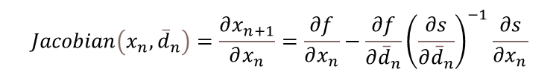
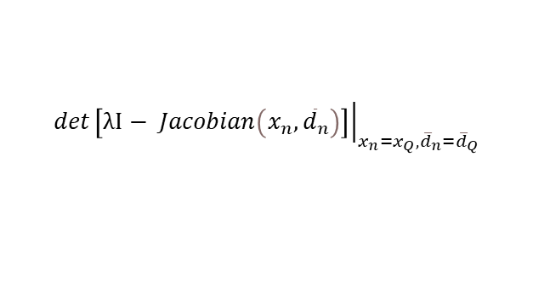
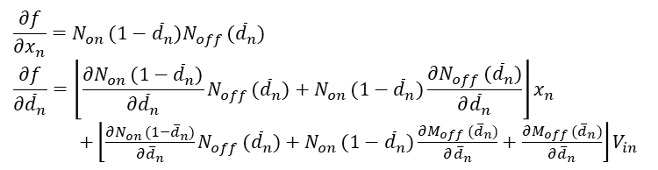
Theoretical Analysis with Iteration Mapping
$$x_{n+1}=f\left(x_{n},{\overline{d}}_{n}\right)=N_{on }(1−{\overline{d}}_{n})N_{off }({{\overline{d}}_{n})x}_{n}+[N_{on }(1−{\overline{d}}_{n})M_{off}({\overline{d}}_{n})+M_{on}(1−{\overline{d}}_{n})]V_{in}$$
The iteration map could help to study the stability of the system, we can calculate the eigenvalues near the equilibrium point, analyze the instability process of the regular state of the system when some parameters change.
So the jacobian matrix will be:
$$Jacobian\left(x_{n},{\overline{d}}_{n}\right)=\frac{∂x_{n+1}}{∂x_{n}}=\frac{∂f}{∂x_{n}}−\frac{∂f}{∂{\overline{d}}_{n}}{\left(\frac{∂s}{∂{\overline{d}}_{n}}\right)}^{−1}\frac{∂s}{∂x_{n}}$$
$$\frac{∂f}{∂x_{n}}=N_{on }(1−{\overline{d}}_{n})N_{off }({\overline{d}}_{n})$$
$$\frac{∂f}{∂{\overline{d}}_{n}}=\left\lfloor \frac{∂N_{on }(1−{\overline{d}}_{n})}{∂{\overline{d}}_{n}}N_{off }({\overline{d}}_{n})+N_{on }(1−{\overline{d}}_{n})\frac{∂N_{off }({\overline{d}}_{n})}{∂{\overline{d}}_{n}}\right\rfloor x_{n}$$
$+\left\lfloor \frac{∂N_{on }(1−{\overline{d}}_{n})}{∂{\overline{d}}_{n}}N_{off }({\overline{d}}_{n})+N_{on }(1−{\overline{d}}_{n})\frac{∂M_{off }({\overline{d}}_{n})}{∂{\overline{d}}_{n}}+\frac{∂M_{off }({\overline{d}}_{n})}{∂{\overline{d}}_{n}}\right\rfloor V_{in}$
Then the eigenvalue for the equilibrium point can be calculated as:
$${det\left.\left[λI− Jacobian\left(x_{n},{\overline{d}}_{n}\right)\right]\right|}_{x_{n}=x_{Q},{\overline{d}}_{n}={\overline{d}}_{Q}}$$
[4] Zhou, Y., Tse, C.K., Qiu, S.S. and Lau, F.C., 2003. Applying resonant parametric perturbation to control chaos in the buck dc/dc converter with phase shift and frequency mismatch considerations. International Journal of Bifurcation and Chaos, 13(11), pp.3459-3471.

Slide 13
Theoretical Analysis with Iteration Mapping
Stability criterion: characteristic multipliers are the eigenvalues of the Jacobian of a discrete-time iterative system.
The system is locally stable if all the characteristic multipliers have a magnitude of less than 1 (in unity cycle)
When the first multiplier go out of the unity cycle, the bifurcation begins
Unity Circle
(0,0)
Bifurcation happens
Vin =24.516V
As the figure show right, under specific condition R=22Ω, L=20mH, C=47uF, fs =2500Hz, the input voltage changes from 20~35V, the system eigenvalues will first converge to the real axis and then separate in different direction. (1-periodic evolution to 2-periodic)
[4] Zhou, Y., Tse, C.K., Qiu, S.S. and Lau, F.C., 2003. Applying resonant parametric perturbation to control chaos in the buck dc/dc converter with phase shift and frequency mismatch considerations. International Journal of Bifurcation and Chaos, 13(11), pp.3459-3471.

Slide 14
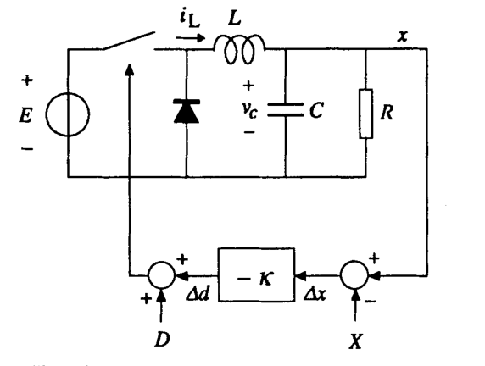

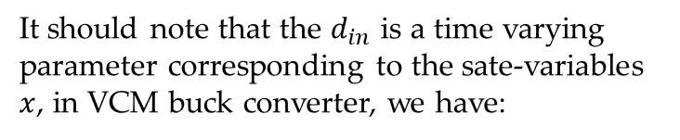
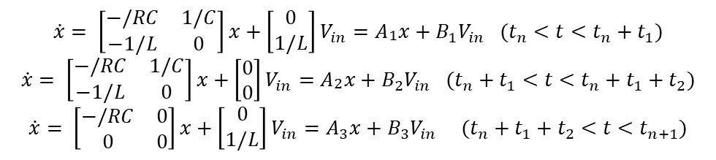
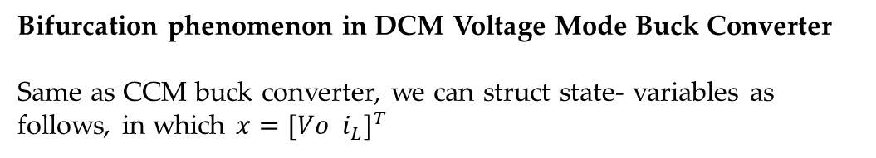
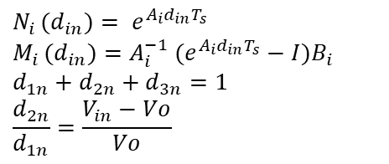
Discrete iteration mapping for DCM Buck
Bifurcation phenomenon in DCM Voltage Mode Buck Converter
Same as CCM buck converter, we can struct state- variables as follows, in which $x={[Vo i_{L}]}^{T}$
$$\dot{x}= {\left[\begin{matrix}−/RC & 1/C \\ −1/L & 0\end{matrix}\right]x+\left[\begin{matrix}0 \\ 1/L\end{matrix}\right]V_{in}=A}_{\begin{aligned}1 \\ \end{aligned}}x+B_{1}V_{in} (t_{n}<t<t_{n}+t_{1})$$
$$\dot{x}= {\left[\begin{matrix}−/RC & 1/C \\ −1/L & 0\end{matrix}\right]x+\left[\begin{matrix}0 \\ 0\end{matrix}\right]V_{in}=A}_{\begin{aligned}2 \\ \end{aligned}}x+B_{2}V_{in} (t_{n}+t_{1}<t<t_{n}+t_{1}+t_{2})$$
$$\dot{x}= {\left[\begin{matrix}−/RC & 0 \\ 0 & 0\end{matrix}\right]x+\left[\begin{matrix}0 \\ 1/L\end{matrix}\right]V_{in}=A}_{3}x+B_{3}V_{in} (t_{n}+t_{1}+t_{2}<t<t_{n+1})$$
Solving these state equation then we can obtain the expression of iterative map
$$x_{n+1}=f\left(x_{n},d_{1n}\right)=N_{3 }(d_{3n})N_{2 }(d_{2n})N_{1 }({d_{1n})x}_{n}+[N_{3 }(d_{3n})N_{2 }(d_{2n})M_{1}(d_{1n})+N_{3 }(d_{3n})M_{2}(d_{2n})+M_{3}(d_{3n})]V_{in}$$
$$N_{i }(d_{in})= e^{A_{i}d_{in}T_{s}}$$
$$M_{i }(d_{in})=A_{i}^{−1} (e^{A_{i}d_{in}T_{s}}−I)B_{i}$$
$$d_{1n}+d_{2n}+d_{3n}=1$$
$$\frac{d_{2n}}{d_{1n}}=\frac{V_{in}−Vo}{Vo}$$
It should note that the $d_{in}$ is a time varying parameter corresponding to the sate-variables $x$, in VCM buck converter, we have:
$$d_{1n}=D−K\left({Vo}_{n}−V_{ref}\right)$$

Slide 15


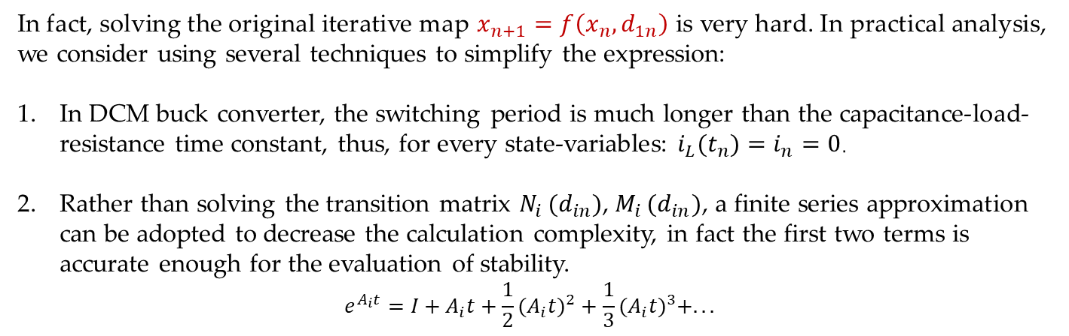
Discrete iteration mapping for DCM Buck
In fact, solving the original iterative map $x_{n+1}=f\left(x_{n},d_{1n}\right)$is very hard. In practical analysis, we consider using several techniques to simplify the expression:
In DCM buck converter, the switching period is much longer than the capacitance-load-resistance time constant, thus, for every state-variables: $i_{L}(t_{n})=i_{n}=0$.
Rather than solving the transition matrix $N_{i }(d_{in})$, $M_{i }(d_{in})$, a finite series approximation can be adopted to decrease the calculation complexity, in fact the first two terms is accurate enough for the evaluation of stability.
$$e^{A_{i}t}=I+A_{i}t+{{\frac{1}{2}(A}_{i}t)}^{2}+{{\frac{1}{3}(A}_{i}t)}^{3}+...$$
After simplification, we can rewrite the iterative map:
$${Vo}_{n+1}=g\left({Vo}_{n},d_{1n}\right)=α{Vo}_{n}+β\frac{d_{1n}^{2}V_{in}(V_{in}−{Vo}_{n} )}{{Vo}_{n} }$$
$α=1−\frac{T_{s}}{RC}+\frac{{T_{s}}^{2}}{{2(RC)}^{2}}$, $β=\frac{R{T_{s}}^{2}}{2LCR}$
[7]C. K. Tse, “Chaos from a buck switching regulator operating in discontinuous mode,” Int. J. Circ. Theor. Appl., vol. 22, no. 4, pp. 263–278, Jul. 1994, doi: 10.1002/cta.4490220403.

Slide 16
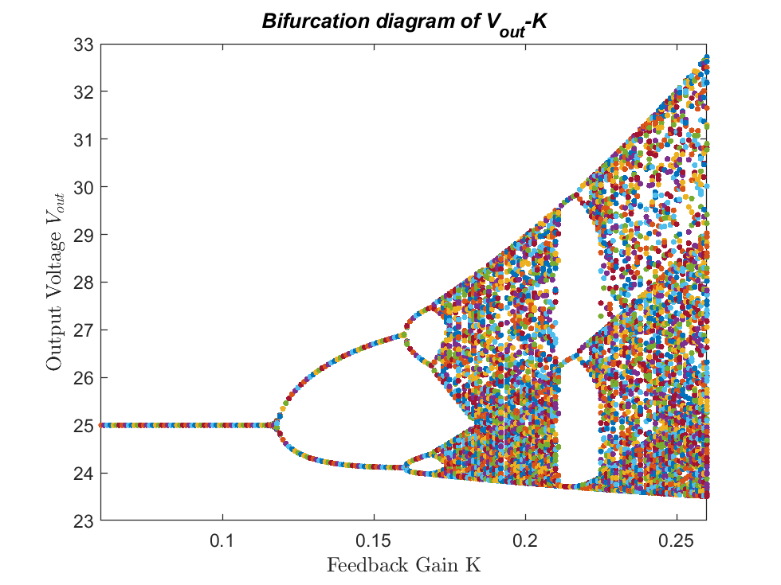
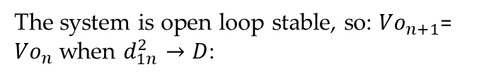
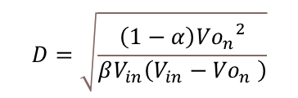
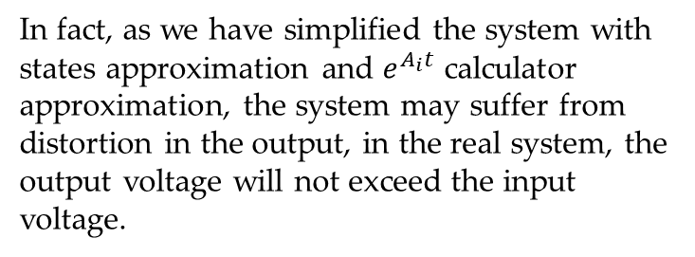
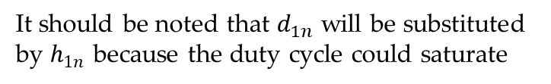
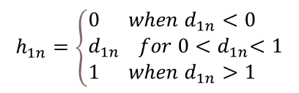

Discrete iteration mapping for DCM Buck
$${Vo}_{n+1}=g\left({Vo}_{n},d_{1n}\right)=α{Vo}_{n}+β\frac{h_{1n}^{2}V_{in}(V_{in}−{Vo}_{n} )}{{Vo}_{n} }$$
It should be noted that $d_{1n}$ will be substituted by $h_{1n}$ because the duty cycle could saturate
Chaos
$$h_{1n}=\left\{\begin{aligned}&0 when d_{1n}<0 \\ &d_{1n} for 0{<d}_{1n}<1 \\ &1 when d_{1n}>1\end{aligned}\right.$$
Period-4
Period-2
Stable
The system is open loop stable, so: ${Vo}_{n+1}$= ${Vo}_{n}$ when $d_{1n}^{2}→D$:
$$D=\sqrt{\frac{\left(1−α\right){{Vo}_{n}}^{2}}{βV_{in}\left(V_{in}−{Vo}_{n} \right)}}$$
In fact, as we have simplified the system with states approximation and $e^{A_{i}t}$ calculator approximation, the system may suffer from distortion in the output, in the real system, the output voltage will not exceed the input voltage.
As the figure show above, under specific condition Vin=33V, R =12.5Ω, L=208uH, C=222uF, fs=3000Hz, the discrete iteration mapping predicts feedback gain value will bifurcate the system.

Slide 17
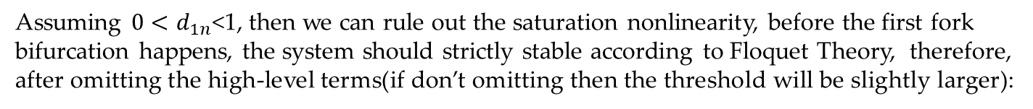
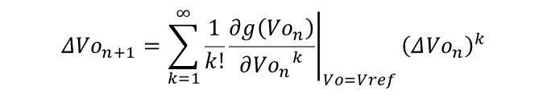
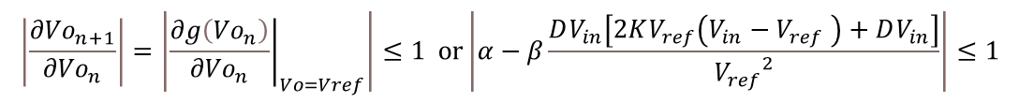
Stability Analysis under Discrete iteration map
Stability Analysis using iterative map
In terms of the stable closed-loop system with one single steady-state fixed point, the Taylor series around the equilibrium is a helpful tools to determine the threshold of bifurcation happens:
$$Δ{Vo}_{n+1}=\sum_{k=1}^{∞}{\frac{1}{k!}}{\left.\frac{∂g\left({Vo}_{n}\right)}{∂{{Vo}_{n}}^{k}}\right|}_{Vo=Vref}{\left(Δ{Vo}_{n}\right)}^{k}$$
Assuming $0<d_{1n}$<1, then we can rule out the saturation nonlinearity, before the first fork bifurcation happens, the system should strictly stable according to Floquet Theory, therefore, after omitting the high-level terms(if don’t omitting then the threshold will be slightly larger):
$$\left|\frac{∂{Vo}_{n+1}}{∂{Vo}_{n}}\right|=\left|{\left.\frac{∂g\left({Vo}_{n}\right)}{∂{Vo}_{n}}\right|}_{Vo=Vref}\right|≤1 or\left|α−β\frac{DV_{in}\left[2KV_{ref}\left(V_{in}−V_{ref} \right)+DV_{in}\right]}{{V_{ref}}^{2}}\right|≤1$$
After calculation we can obtain Kc = 0.1335, go back to the bifurcation plot using iterative map, the first fork bifurcation can be predicted accurately.
[7]C. K. Tse, “Chaos from a buck switching regulator operating in discontinuous mode,” Int. J. Circ. Theor. Appl., vol. 22, no. 4, pp. 263–278, Jul. 1994, doi: 10.1002/cta.4490220403.

Slide 18
DCM buck simulation with bifurcation parameters
Bifurcation phenomenon in DCM Buck Converter
Like CCM buck converter, DCM buck converter can go through bifurcation with multiple parameters
The left diagram is the phase portrait when the feedback gain changing from 0.1~0.187, the state variables will go through one/two/four period and finally lead to chaos.

Slide 19
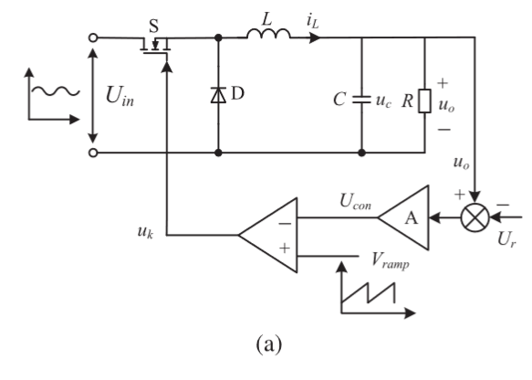
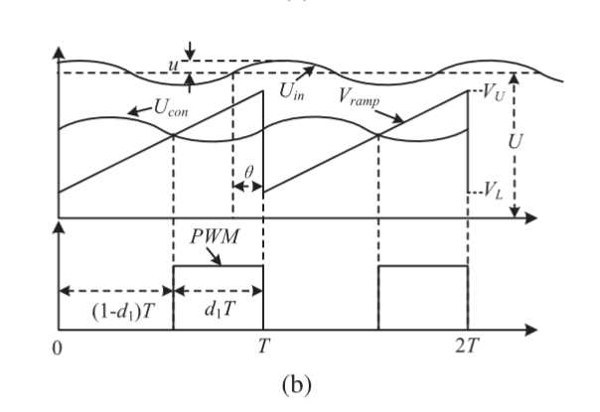
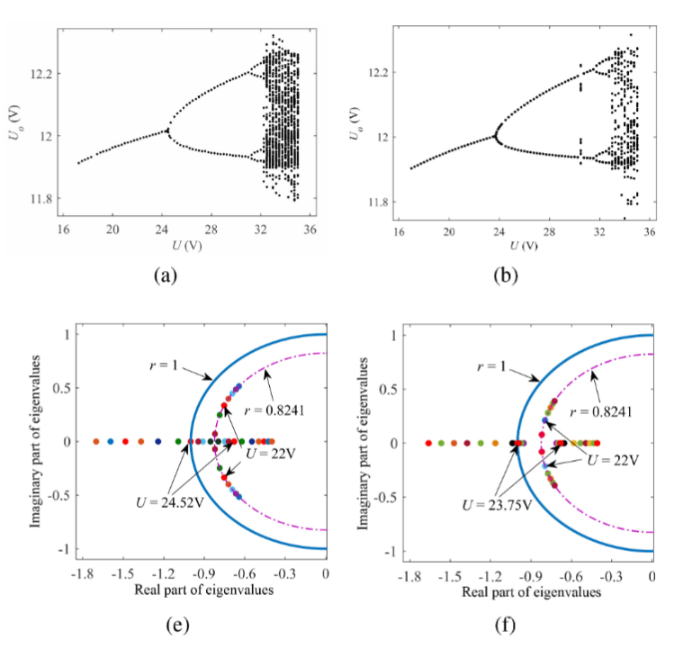
Possible Application for Buck complex behavior
Cascade converters in renewable energy generation are usually cascaded from two subconverters. The output voltage of the front end is usually the ripple dc voltage, which serves as the input voltage of the downstream dc–dc converter;
The stability of a dc–dc converter with periodic input ripple voltage can perform chaotic behavior;
These complex behavior and stability can be analyzed by iterative mapping and Jacobian matrix eigenvalues.
[1] W. Hu, R. Yang, X. Wang, and F. Zhang, “Stability Analysis of Voltage Controlled Buck Converter Feed From a Periodic Input,” IEEE Transactions on Industrial Electronics, vol. 68, no. 4, pp. 3079–3089, Apr. 2021, doi: 10.1109/TIE.2020.2982116.

Slide 20
Conclusion
Buck Converter can have very complex behavior coming from varying parameters: Circuit components values, Input voltage; as well as control parameters, feedback gains, reference;
Two category of methods are widely used to predicts and analysis the complex behavior: complete numeric state equations and discrete iterative mapping;
There are many virtualization techniques to observe the chaotic system, including bifurcation plot, phase portrait, and Poincare map

Slide 21
Bibliography
[1] W. Hu, R. Yang, X. Wang, and F. Zhang, “Stability Analysis of Voltage Controlled Buck Converter Feed From a Periodic Input,” IEEE Transactions on Industrial Electronics, vol. 68, no. 4, pp. 3079–3089, Apr. 2021, doi: 10.1109/TIE.2020.2982116.
[2] X. Feng, C. Bi, Y. Xiang, and Q. Zhang, “Dynamical analysis of the DCM buck converter,” in 2013 International Conference on Communications, Circuits and Systems (ICCCAS), Nov. 2013, vol. 2, pp. 442–445. doi: 10.1109/ICCCAS.2013.6765378.
[3] C. K. M. Tse, “Analysis and Control of Power Converters,” p. 43, 2011.
[4] Y. Zhou, C. K. Tse, S.-S. Qiu, and F. C. M. Lau, “APPLYING RESONANT PARAMETRIC PERTURBATION TO CONTROL CHAOS IN THE BUCK DC/DC CONVERTER WITH PHASE SHIFT AND FREQUENCY MISMATCH CONSIDERATIONS,” Int. J. Bifurcation Chaos, vol. 13, no. 11, pp. 3459–3471, Nov. 2003, doi: 10.1142/S0218127403008685.
[5] M. di Bernardo and F. Vasca, “Discrete-time maps for the analysis of bifurcations and chaos in DC/DC converters,” IEEE Trans. Circuits Syst. I, vol. 47, no. 2, pp. 130–143, Feb. 2000, doi: 10.1109/81.828567.
[6] G. Yuan, S. Banerjee, E. Ott, and J. A. Yorke, “Border-collision bifurcations in the buck converter,” IEEE Transactions on Circuits and Systems I: Fundamental Theory and Applications, vol. 45, no. 7, pp. 707–716, Jul. 1998, doi: 10.1109/81.703837.
[7] C. K. Tse, “Chaos from a buck switching regulator operating in discontinuous mode,” Int. J. Circ. Theor. Appl., vol. 22, no. 4, pp. 263–278, Jul. 1994, doi: 10.1002/cta.4490220403.
[8] S. Pavljasevic and D. Maksimovic, “Using a discrete-time model for large-signal analysis of a current-programmed boost converter,” in PESC ’91 Record 22nd Annual IEEE Power Electronics Specialists Conference, Jun. 1991, pp. 715–721. doi: 10.1109/PESC.1991.162755.
[9] E. Rodríguez Vilamitjana, A. El Aroudi, and E. Alarcón, Chaos in Switching Converters for Power Management. New York, NY: Springer New York, 2013. doi: 10.1007/978-1-4614-2128-3.

